Slide 1
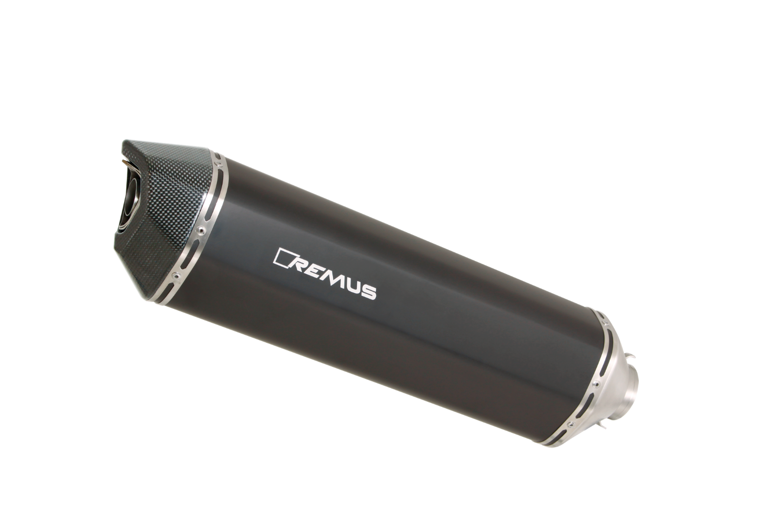
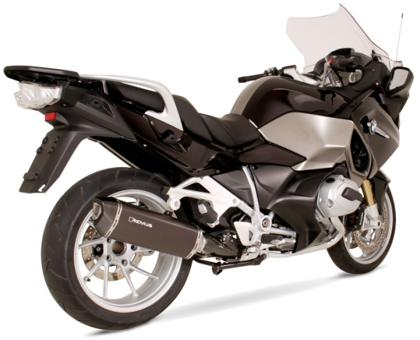
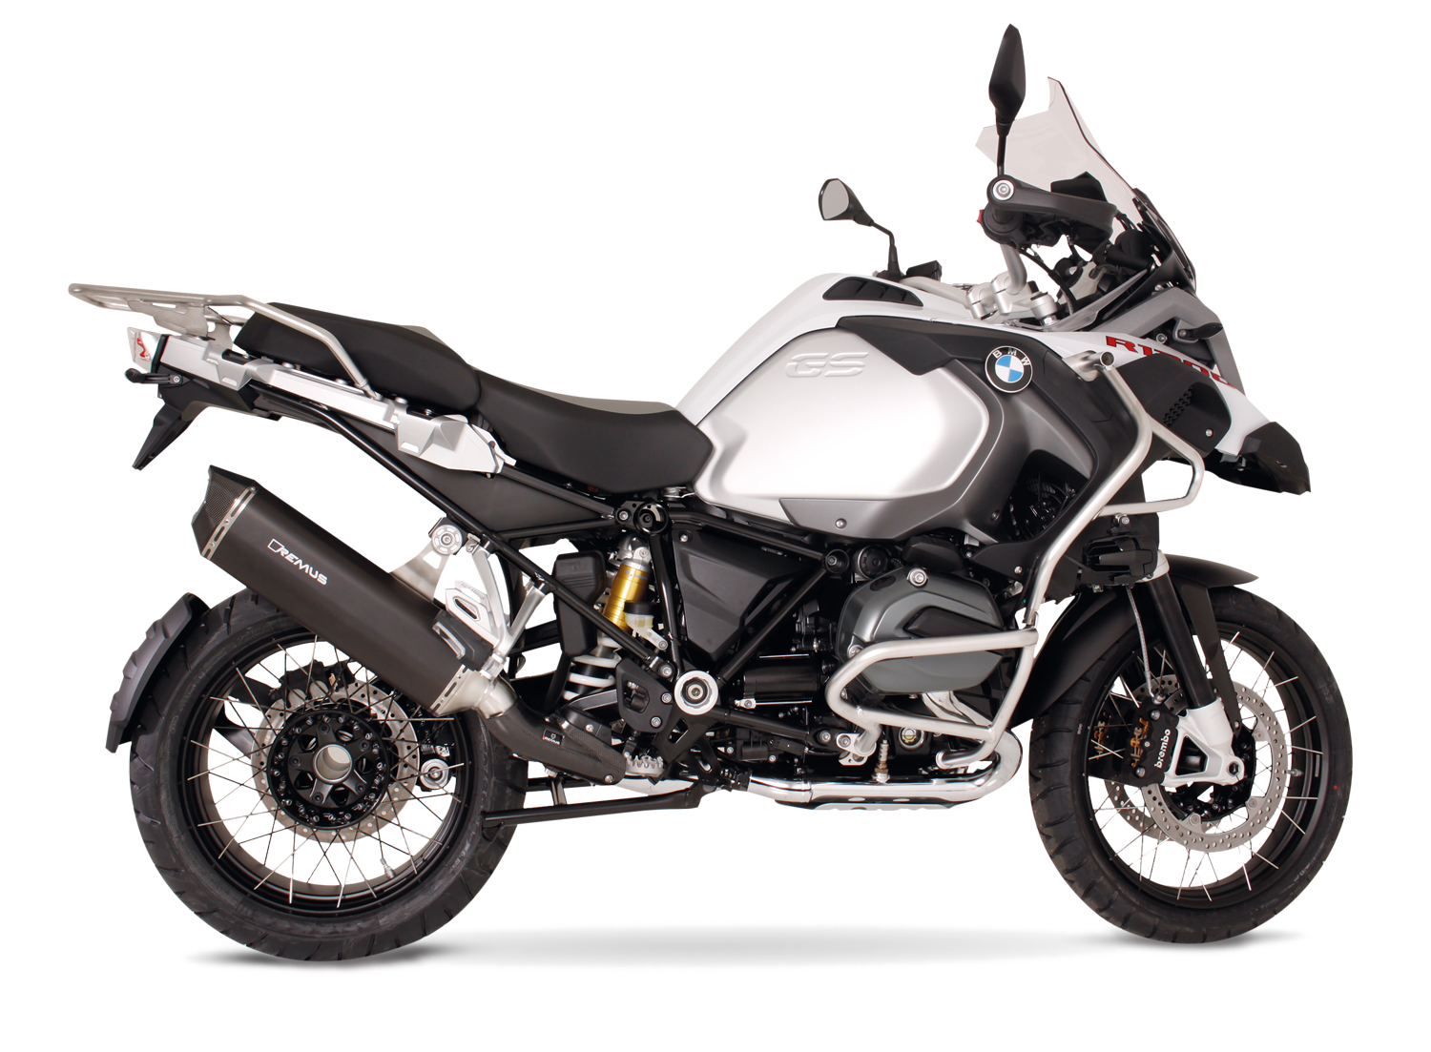
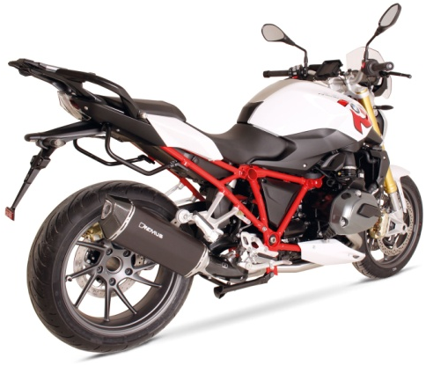
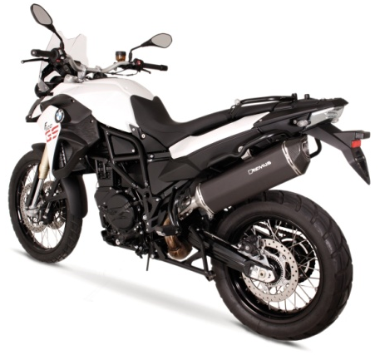
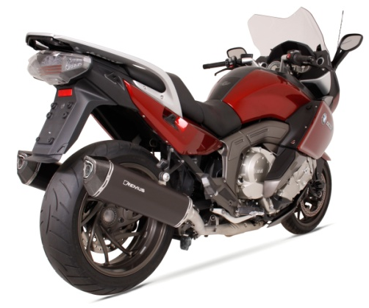
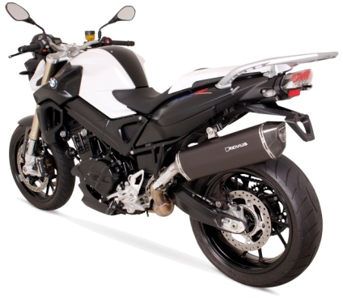
BIKE INFO 36 / 2015
REMUS BLACK HAWK for BMW models
Abbildung kann vom Original abweichen / Picture can deviate from original product

Slide 2
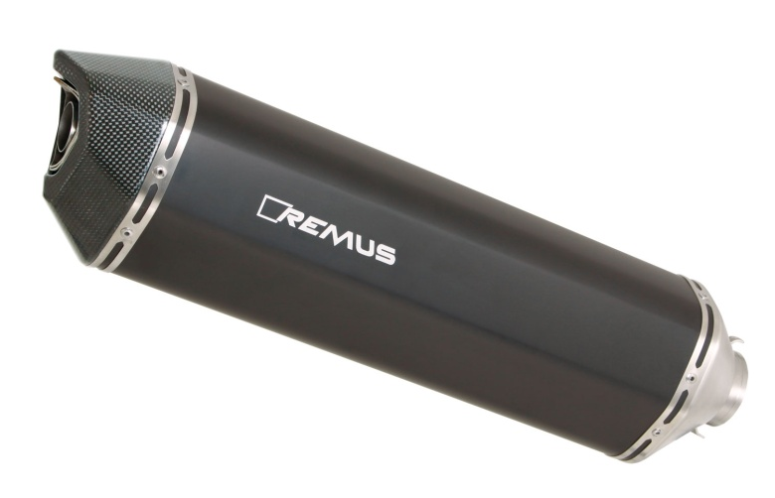
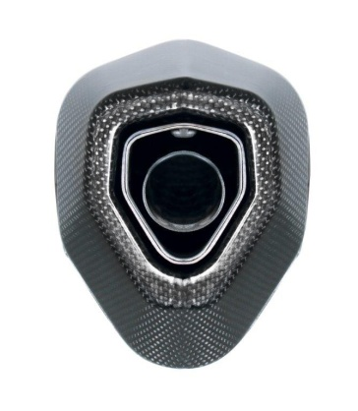
REMUS BLACK HAWK
mit EG Genehmigung / with EEC homologation
Hexagonale Form / Hexagonal geometry
Breite x Höhe / Width x height: ~ 105 x 137 mm
Mantellänge von 350 bis 420 mm, motorradabhängig /
Sleeve length from 350 to 420 mm, depends on motorcycle
Mantelmaterial Edelstahl schwarz lackiert /
Sleeve materials: Stainless steel black painted
Einlasskappe: Edelstahl / Inlet cap: Stainless steel
Endkappe: Carbon / End cap: Carbon
Gewicht ab 1,96 kg / Weight: from 1,96 kg
Abbildung kann vom Original abweichen / Picture can deviate from original product

Slide 3
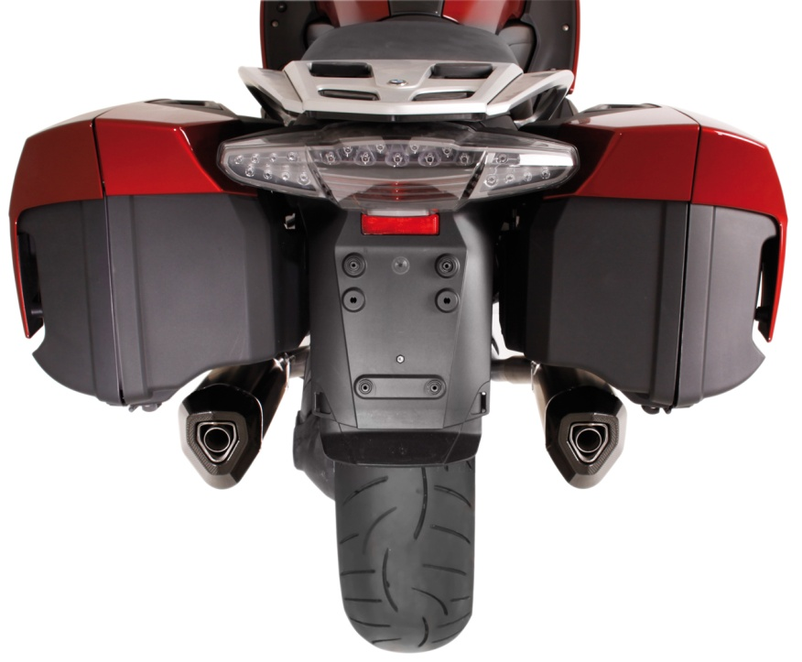
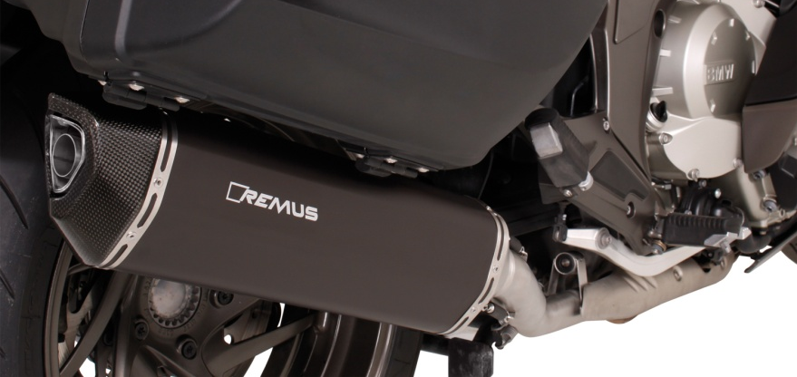
BMW K 1600 GT & BLACK HAWK
Abbildung kann vom Original abweichen / Picture can deviate from original product

Slide 4
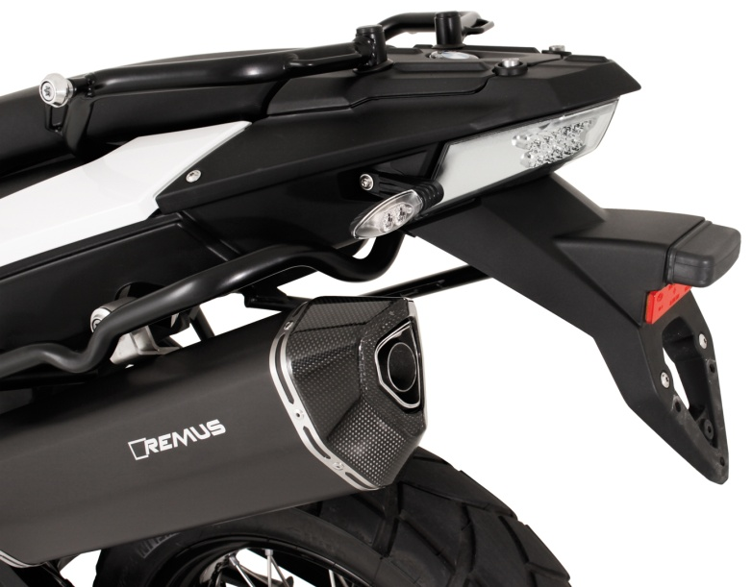
BMW F 800 GS & BLACK HAWK
Abbildung kann vom Original abweichen / Picture can deviate from original product

Slide 5
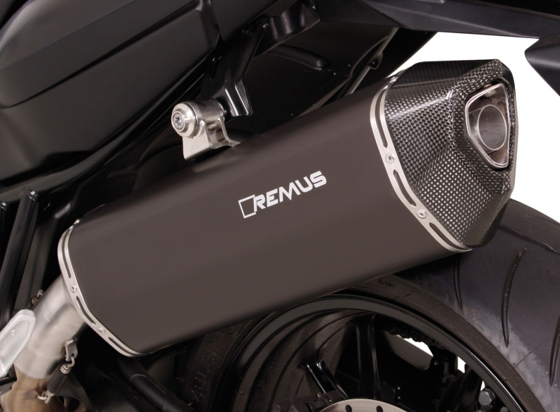
BMW F 800 R & BLACK HAWK
Abbildung kann vom Original abweichen / Picture can deviate from original product

Slide 6
BMW R 1200 GS & BLACK HAWK
Abbildung kann vom Original abweichen / Picture can deviate from original product

Slide 7
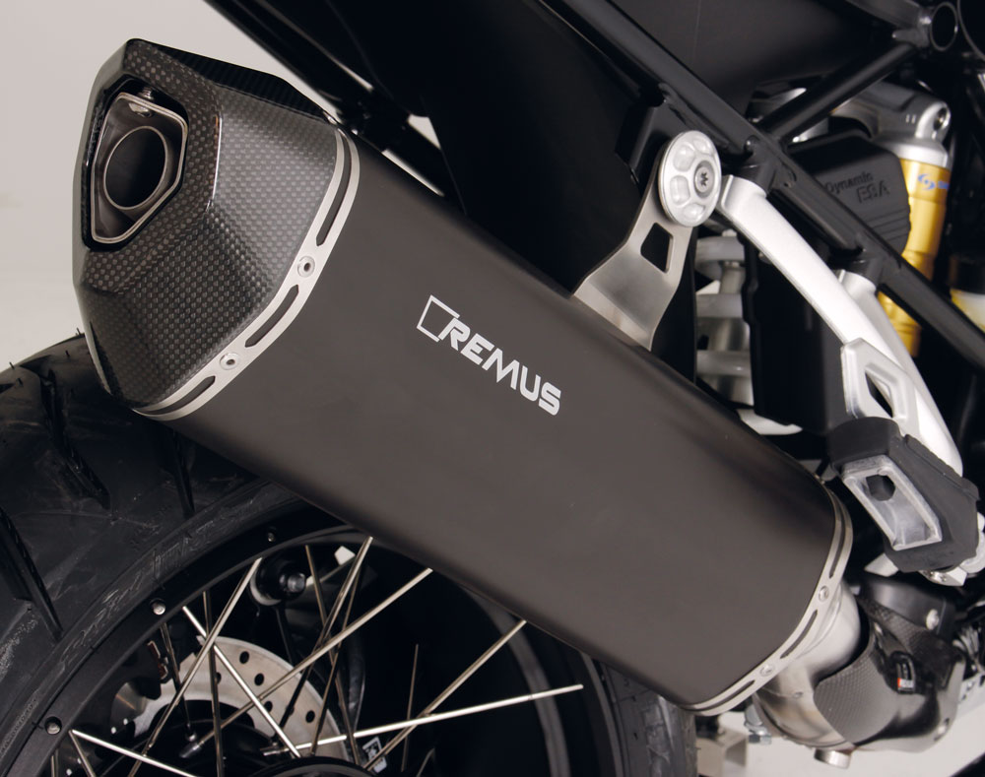
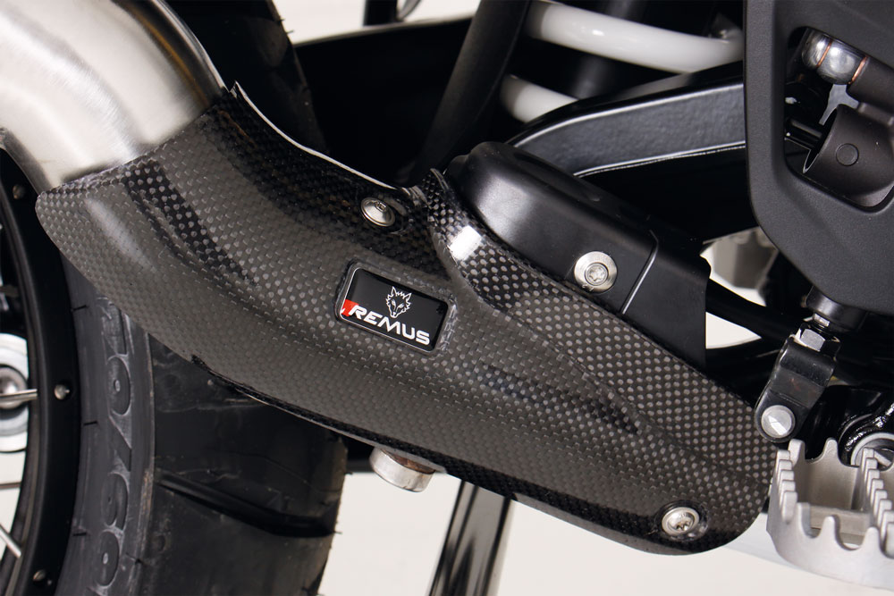
BMW R 1200 GS & BLACK HAWK
Carbon Hitzeschutzabdeckung / carbon heat protection shield
Abbildung kann vom Original abweichen / Picture can deviate from original product

Slide 8
BMW R 1200 R & BLACK HAWK
Abbildung kann vom Original abweichen / Picture can deviate from original product

Slide 9
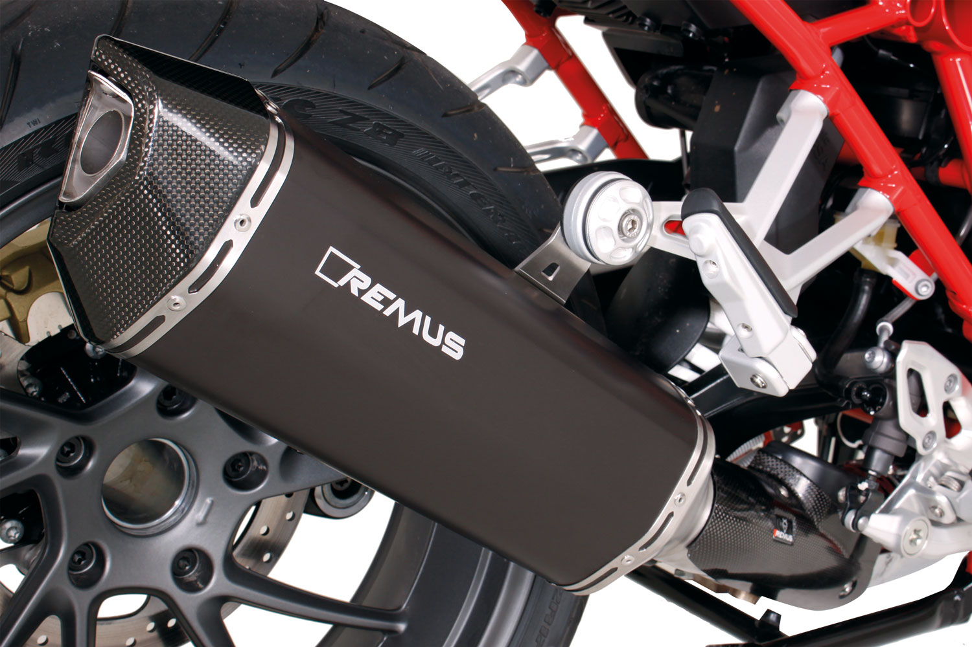
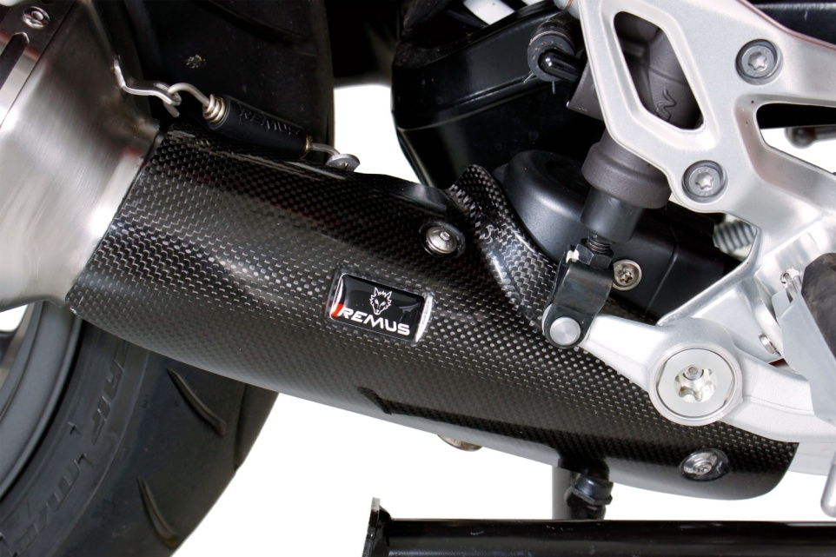
BMW R 1200 R & BLACK HAWK
Carbon Hitzeschutzabdeckung / carbon heat protection shield
Abbildung kann vom Original abweichen / Picture can deviate from original product

Slide 10
BMW R 1200 RT & BLACK HAWK
Abbildung kann vom Original abweichen / Picture can deviate from original product

Slide 11
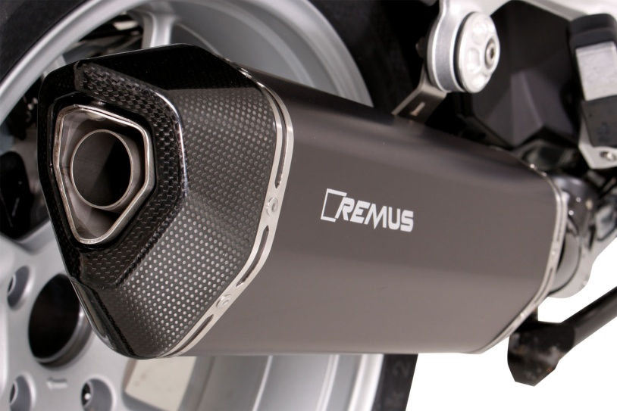
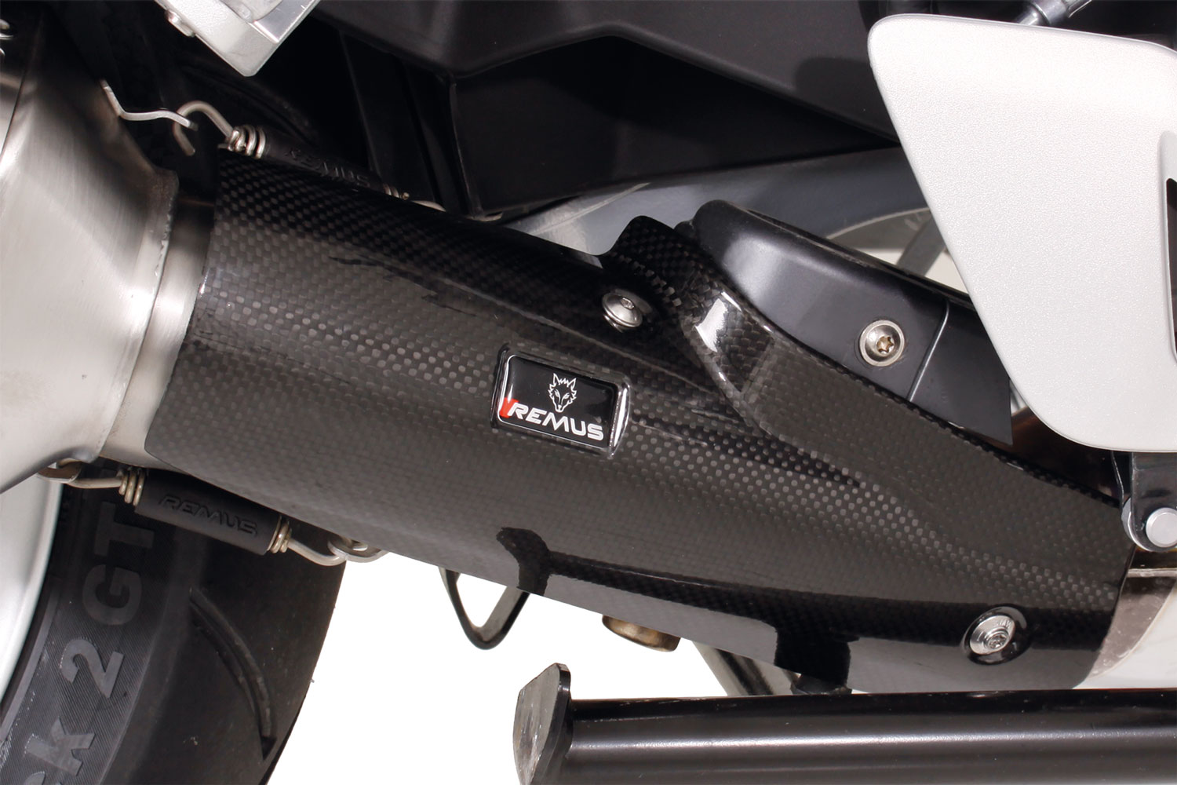
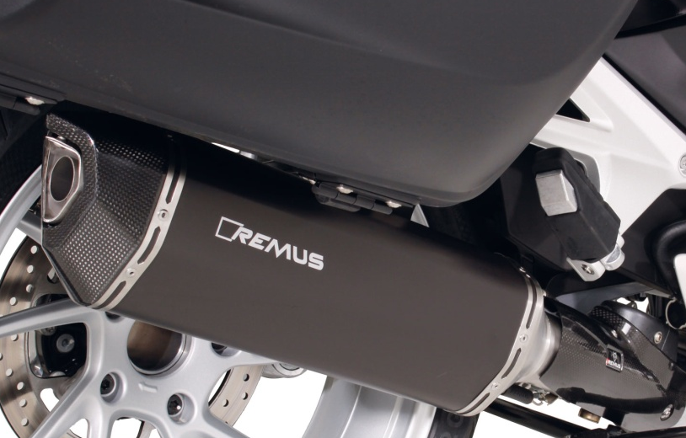
BMW R 1200 RT & BLACK HAWK
Carbon Hitzeschutzabdeckung / carbon heat protection shield
Abbildung kann vom Original abweichen / Picture can deviate from original product

Slide 12
Liste mit Detailartikelnummern / list with detail order numbers
Modell - type | Bj. year | Ømm | Beschreibung | description | Typ type | Mantel Variante | sleeve version | Artikelnummer order number | EUR exkl. MwSt. EUR excl. VAT
F 650 GS E8GS, 52 kW | 08-12 |  | Edelstahl - Krümmer (2-1) ohne Kat. anstelle Serienkrümmer (nicht für F 800 GS Adventure) | stainless steel header (2-1) no cat. instead of original header (not for F 800 GS Adventure) | Race (no EG/ABE/EEC) |  |  | 0101 085208 | 420,00
F 700 GS E8GS, 55 kW | 12- |  | HEXACONE passend zum Serienkrümmer | HEXACONE fits onto original header | EG/ABE/EEC | Titan | titanium | 4882 085208 | 502,00
F 800 GS E8GS, 63 kW | 08- |  | BLACK HAWK passend zum Serienkrümmer | BLACK HAWK fits onto original header | EG/ABE/EEC | Edelstahl schwarz | Stainless steel black | 64782 085208 | 447,00
F 800 GS Triple Black | 12-
F 800 GS Adventure | 13-
F 800 R | 09- |  | HEXACONE | HEXACONE | EG/ABE/EEC | Edelstahl | stainless steel | 4682 085209 | 447,00
E8ST, 63 kW |  |  | HEXACONE | HEXACONE | EG/ABE/EEC | Titan | titanium | 4882 085209 | 502,00
F 800 R | 15- |  | BLACK HAWK | BLACK HAWK | EG/ABE/EEC | Edelstahl schwarz | Stainless steel black | 64782 085209 | 447,00
E8ST, 66 kW
F 800 GT | 13-
K 1600 GT | 11- | 54 | Edelstahl - Krümmer (6-2) ohne Kat. anstelle Serienkrümmer | stainless steel header (6-2) no cat. instead of original header | Race (no EG/ABE/EEC) |  |  | 0101 089911 | 875,00
K 1600 GTL |  |  | Verbindungsrohr links | connecting tube left | EG/ABE/EEC |  |  | 0105 089911L | 101,00
118 kW |  |  | Verbindungsrohr rechts | connecting tube right | EG/ABE/EEC |  |  | 0105 089911R | 101,00
 |  |  | HEXACONE links | HEXACONE left | EG/ABE/EEC | Carbon | carbon | 4482 100054L | 461,00
 |  |  | HEXACONE rechts | HEXACONE right | EG/ABE/EEC | Carbon | carbon | 4482 100054 | 461,00
 |  |  | HEXACONE links | HEXACONE left | EG/ABE/EEC | Titan | titanium | 4882 100054L | 447,00
 |  |  | HEXACONE rechts | HEXACONE right | EG/ABE/EEC | Titan | titanium | 4882 100054 | 447,00
 |  |  | BLACK HAWK links | BLACK HAWK left | EG/ABE/EEC | Edelstahl schwarz | Stainless steel black | 64782 100054L | 389,00
 |  |  | BLACK HAWK rechts | BLACK HAWK right | EG/ABE/EEC | Edelstahl schwarz | Stainless steel black | 64782 100054 | 389,00
R 1200 GS | 13- |  | Edelstahl - Krümmer (2-1) ohne Kat. anstelle Serienkrümmer | stainless steel header (2-1) no cat. Instead of original header | Race (no EG/ABE/EEC) |  |  | 0101 088115 | 458,00
R 1200 GS Adventure | 14- |  | HEXACONE mit Carbon Hitzeschutzabdeckung | HEXACONE with Carbon heat protecting shield | EG/ABE/EEC | Edelstahl | stainless steel | 4682 088013 | 557,00
92 kW |  |  | HEXACONE mit Carbon Hitzeschutzabdeckung | HEXACONE with Carbon heat protecting shield | EG/ABE/EEC | Carbon | Carbon | 4482 088013 | 626,00
 |  |  | HEXACONE mit Carbon Hitzeschutzabdeckung | HEXACONE with Carbon heat protecting shield | EG/ABE/EEC | Titan | titanium | 4882 088013 | 612,00
 |  |  | BLACK HAWK mit Carbon Hitzeschutzabdeckung | BLACK HAWK with Carbon heat protecting shield | EG/ABE/EEC | Edelstahl schwarz | Stainless steel black | 64782 088013 | 557,00
R 1200 R | 15- | 66 | Edelstahl - Krümmer (2-1) ohne Kat. anstelle Serienkrümmer | stainless steel header (2-1) no cat. instead of original header | Race (no EG/ABE/EEC) |  |  | 0101 088115 | 458,00
R 1200 RS |  |  | Edelstahl - Verbindungsrohr mit Carbon Hitzeschutzabdeckung | stainless steel connecting tube incl. Carbon heat protecting shield | EG/ABE/EEC |  |  | 0105 088115 | 218,00
92 kW |  |  | HEXACONE | HEXACONE | EG/ABE/EEC | Edelstahl | stainless steel | 4682 088015 | 389,00
 |  |  | HEXACONE | HEXACONE | EG/ABE/EEC | Carbon | carbon | 4482 088015 | 461,00
 |  |  | HEXACONE | HEXACONE | EG/ABE/EEC | Titan | titanium | 4882 088015 | 447,00
 |  |  | BLACK HAWK | BLACK HAWK | EG/ABE/EEC | Edelstahl schwarz | Stainless steel black | 64782 088015 | 389,00
R 1200 RT | 14- | 66 | Edelstahl - Krümmer (2-1) ohne Kat. anstelle Serienkrümmer | stainless steel header (2-1) no cat. instead of original header | Race (no EG/ABE/EEC) |  |  | 0101 088115 | 458,00
92 kW |  |  | Edelstahl - Verbindungsrohr mit Carbon Hitzeschutzabdeckung | stainless steel connecting tube incl. Carbon heat protecting shield | EG/ABE/EEC |  |  | 0105 088014 | 218,00
 |  |  | HEXACONE | HEXACONE | EG/ABE/EEC | Edelstahl | stainless steel | 4682 088014 | 389,00
 |  |  | HEXACONE | HEXACONE | EG/ABE/EEC | Carbon | carbon | 4482 088014 | 461,00
 |  |  | HEXACONE | HEXACONE | EG/ABE/EEC | Titan | titanium | 4882 088014 | 447,00
 |  |  | BLACK HAWK | BLACK HAWK | EG/ABE/EEC | Edelstahl schwarz | Stainless steel black | 64782 088014 | 389,00
Preise 2016 in Euro exkl. MwSt. / Prices 2016 in Euro excl. VAT! |  |  |  |  |  |  | Irrtum und Änderung vorbehalten / Errors and omission excepted

Slide 13
Liste mit Setartikelnummern / list with set order numbers
Modell - type | Bj. year | Ømm | Beschreibung | description | Typ | Schalldämpfer | Mantel | sleeve | Setartikelnummer | EUR exkl. MwSt. EUR excl. VAT
 |  |  |  |  | type | muffler | Variante | version | Set ordernumber
F 650 GS | 08-12 |  | Slip on (Schalldämpfer) | slip on (muffler) | EG/ABE/EEC | HEXACONE | Titan | titanium | 094882 085208 | 502,00
E8GS, 52 kW |  |  |  |  | EG/ABE/EEC | BLACK HAWK | Edelstahl schwarz | stainless steel black | 0964782 085208 | 447,00
F 700 GS E8GS, 55 kW | 12- |  | Edelstahl - Krümmer (2-1) ohne Kat. anstelle Serienkrümmer (nicht für F 800 GS Adventure) | stainless steel header (2-1) no cat. instead of original header (nicht für F 800 GS Adventure) | Race (no EG/ABE/EEC) |  | Edelstahl | stainless steel | 0101 085208 | 420,00
F 800 GS | 08-
E8GS, 63 kW
F 800 GS Triple Black | 12-
F 800 GS Adventure | 13-
F 800 R | 09- |  | Slip on (Schalldämpfer) | slip on (muffler) | EG/ABE/EEC | HEXACONE | Edelstahl | stainless steel | 094682 085209 | 447,00
E8ST, 63 kW |  |  |  |  | EG/ABE/EEC | HEXACONE | Titan | titanium | 094882 085209 | 502,00
F 800 R | 15- |  |  |  | EG/ABE/EEC | BLACK HAWK | Edelstahl schwarz | stainless steel black | 0964782 085209 | 447,00
E8ST, 66 kW
F 800 GT | 13-
K 1600 GT | 11- | 54 | Slip on links/rechts (Schalldämpfer mit VBR) | slip on left/right (muffler with connecting tube) | EG/ABE/EEC | HEXACONE | Carbon | carbon | 054482 089911LR | 1.124,00
K 1600 GTL |  |  |  |  | EG/ABE/EEC | HEXACONE | Titan | titanium | 054882 089911LR | 1.096,00
118 kW |  |  |  |  | EG/ABE/EEC | BLACK HAWK | Edelstahl schwarz | stainless steel black | 0564782 089911LR | 980,00
 |  |  | Edelstahl - Krümmer (6-2) ohne Kat. anstelle Serienkrümmer | stainless steel header (6-2) no cat. instead of original header | Race (no EG/ABE/EEC) |  | Edelstahl | stainless steel | 0101 089911 | 875,00
R 1200 GS | 13- |  | Slip on (Schalldämpfer) inkl. | slip on (muffler) incl. CARBON | EG/ABE/EEC | HEXACONE | Edelstahl | stainless steel | 094682 088013 | 557,00
92 kW |  |  | CARBON Hitzeschutzabdeckung | heat protecting shield | EG/ABE/EEC | HEXACONE | Carbon | carbon | 094482 088013 | 626,00
R 1200 GS Adventure | 14- |  |  |  | EG/ABE/EEC | HEXACONE | Titan | titanium | 094882 088013 | 612,00
92 kW |  |  |  |  | EG/ABE/EEC | BLACK HAWK | Edelstahl schwarz | stainless steel black | 0964782 088013 | 557,00
 |  |  | Edelstahl - Krümmer (2-1) ohne Kat. anstelle Serienkrümmer | stainless steel header (2-1) no cat. instead of original header | Race (no EG/ABE/EEC) |  | Edelstahl | stainless steel | 0101 088115 | 458,00
R 1200 RS | 15- | 66 | Slip on (Schalldämpfer mit VBR) | slip on (muffler inkl. connecting tube) incl. | EG/ABE/EEC | HEXACONE | Edelstahl | stainless steel | 054682 088115 | 607,00
R 1200 R |  |  | inkl. CARBON Hitzeschutzabdeckung | CARBON heat protecting shield | EG/ABE/EEC | HEXACONE | Carbon | carbon | 054482 088115 | 679,00
92 kW |  |  |  |  | EG/ABE/EEC | HEXACONE | Titan | titanium | 054882 088115 | 665,00
 |  |  |  |  | EG/ABE/EEC | BLACK HAWK | Edelstahl schwarz | stainless steel black | 0564782 088115 | 607,00
 |  |  | Edelstahl - Krümmer (2-1) ohne Kat. anstelle Serienkrümmer | stainless steel header (2-1) no cat. instead of original header | Race (no EG/ABE/EEC) |  | Edelstahl | stainless steel | 0101 088115 | 458,00
R 1200 RT | 14- | 66 | Slip on (Schalldämpfer mit VBR) | slip on (muffler inkl. connecting tube) incl. | EG/ABE/EEC | HEXACONE | Edelstahl | stainless steel | 054682 088014 | 607,00
 |  |  | inkl. CARBON Hitzeschutzabdeckung | CARBON heat protecting shield | EG/ABE/EEC | HEXACONE | Carbon | carbon | 054482 088014 | 679,00
 |  |  |  |  | EG/ABE/EEC | HEXACONE | Titan | titanium | 054882 088014 | 665,00
 |  |  |  |  | EG/ABE/EEC | BLACK HAWK | Edelstahl schwarz | stainless steel black | 0564782 088014 | 607,00
 |  |  | Edelstahl - Krümmer (2-1) ohne Kat. anstelle Serienkrümmer | stainless steel header (2-1) no cat. instead of original header | Race (no EG/ABE/EEC) |  | Edelstahl | stainless steel | 0101 088115 | 458,00
Preise 2016 in Euro exkl. MwSt. / Prices 2016 in Euro excl. VAT! |  |  |  |  |  |  | Irrtum und Änderung vorbehalten / Errors and omission excepted

